Slide 1
Artificial Intelligence for Games Week 10 – Direct Learning 2 Steve Rabin
For help on projects, email everyone (select and copy this string from the start of any class PowerPoint):
steve.rabin@gmail.com, p.jiankai@digipen.edu, b.hsu@digipen.edu, zak.s@digipen.edu, keaton.sullivan@digipen.edu, john.tseng@digipen.edu, a.roulst@digipen.edu
TAs: Jian Kai Phua, Brandon Hsu, Zak Stephenson, Keaton Sullivan, John Tseng, Andrew Roulst

Slide 2
Questions
In supervised learning, the algorithm is trying to learning from label training data.
In unsupervised learning, the algorithm is trying to find cluster in the data.
What do you call supervised learning with a continuous output variable?
Regression
What do you call supervised learning with a discrete output variable?
Classification
What are 5 problems with neural nets?
Overfitting(overtraining)
Hard to fix bug(hard to find and fix edge cases)
Blackbox
Requires ton of data
Not easy to program(need knowledge and forethinking
Hard to tell whats wrong(wrong data? Not enough data?)

Slide 3
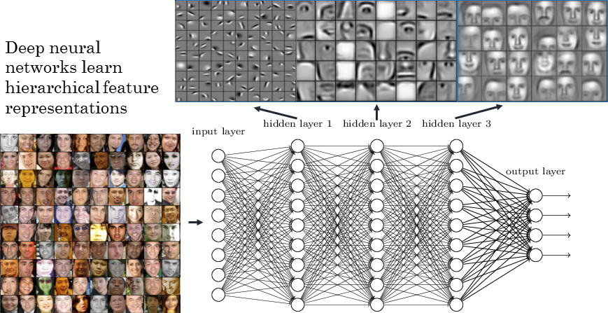

Slide 4
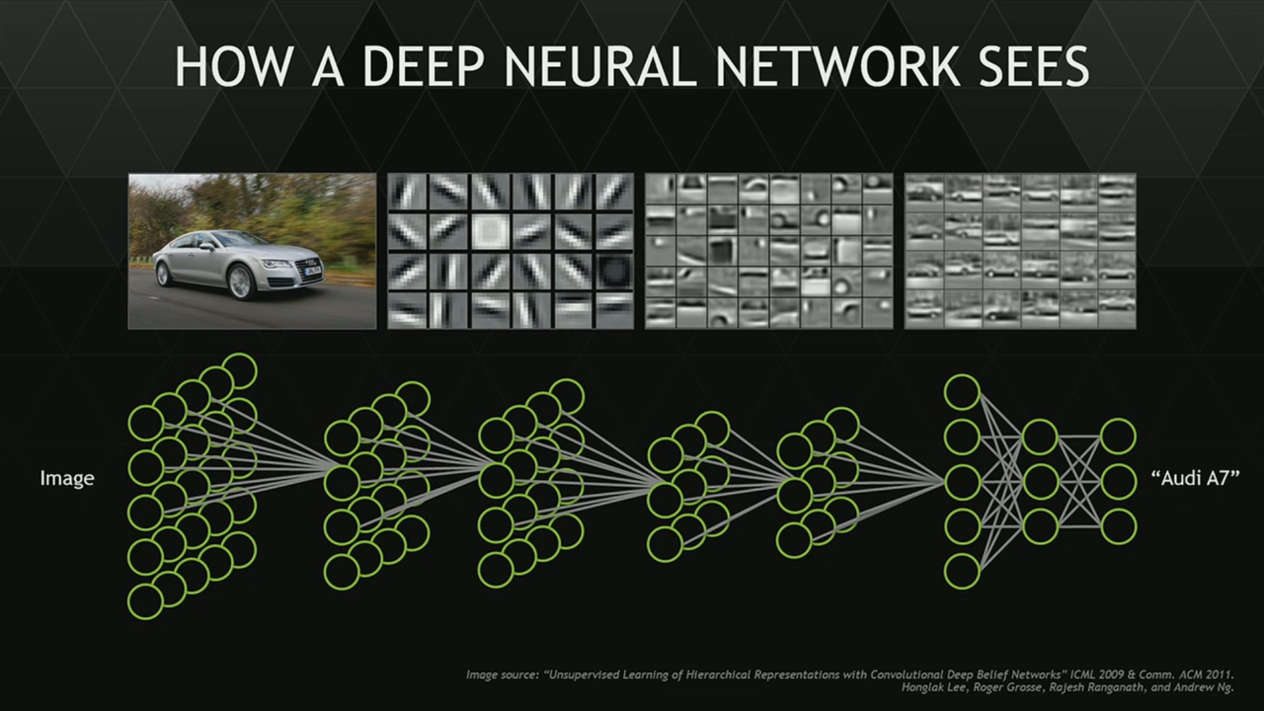

Slide 5
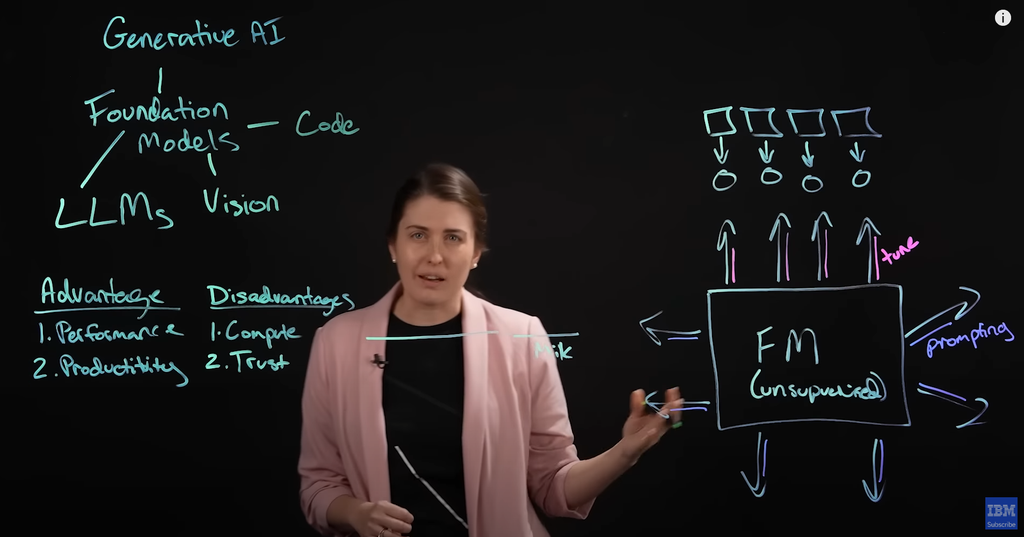
Generative Models
https://www.youtube.com/watch?v=hfIUstzHs9A

Slide 6
Perceptron: Single layer neural network
Simpler version of a NN – Single-layer
Easier to train
Outputs a “yes” or “no”
Either it gets stimulated enough to trigger, or it does not
Drawback:
Can only learn simple (linearly separable) functions

Slide 7
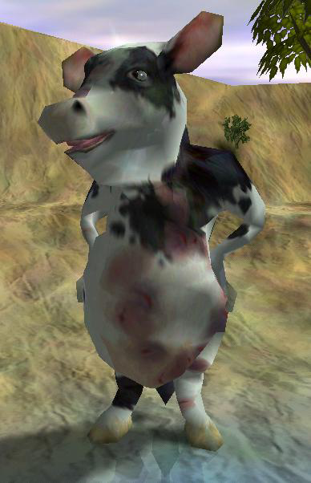


Slide 8
Perceptrons in Black & White
Inputs: Hunger, Tasty food, Unhappiness

Slide 9
Desire Sources |  |  |  |  |  | Actual | Intended (Feedback)
Hunger |  | Tastiness |  | Unhappiness
Value | Weight | Value | Weight | Value | Weight
0.8 | 0.500 | 0.8 | 0.500 | 0 | 0.500 | 0.800 | 1.000
0.8 | 0.564 | 0.2 | 0.564 | 0 | 0.500 | 0.564 | 1.000
0.1 | 0.599 | 0.6 | 0.573 | 0 | 0.500 | 0.404 | 0.200
0 | 0.597 | 0 | 0.560 | 1 | 0.500 | 0.500 | 0.002
0.3 | 0.597 | 0.4 | 0.560 | 1 | 0.450 | 0.853 | 0.400
- | 0.58341 | - | 0.542 | - | 0.4047 | - | -

Slide 10
Desire Sources |  |  |  |  |  | Actual | Intended (Feedback)
Hunger |  | Tastiness |  | Unhappiness
Value | Weight | Value | Weight | Value | Weight
0.8 | 0.500 | 0.8 | 0.500 | 0 | 0.500 | 0.800 | 1.000
0.8 | 0.564 | 0.2 | 0.564 | 0 | 0.500 | 0.564 | 1.000
0.1 | 0.599 | 0.6 | 0.573 | 0 | 0.500 | 0.404 | 0.200
0 | 0.597 | 0 | 0.560 | 1 | 0.500 | 0.500 | 0.002
0.3 | 0.597 | 0.4 | 0.560 | 1 | 0.450 | 0.853 | 0.400
- | 0.58341 | - | 0.542 | - | 0.4047 | - | -

Slide 11
Desire Sources |  |  |  |  |  | Actual | Intended (Feedback)
Hunger |  | Tastiness |  | Unhappiness
Value | Weight | Value | Weight | Value | Weight
0.8 | 0.500 | 0.8 | 0.500 | 0 | 0.500 | 0.800 | 1.000
0.8 | 0.564 | 0.2 | 0.564 | 0 | 0.500 | 0.564 | 1.000
0.1 | 0.599 | 0.6 | 0.573 | 0 | 0.500 | 0.404 | 0.200
0 | 0.597 | 0 | 0.560 | 1 | 0.500 | 0.500 | 0.002
0.3 | 0.597 | 0.4 | 0.560 | 1 | 0.450 | 0.853 | 0.400
- | 0.58341 | - | 0.542 | - | 0.4047 | - | -

Slide 12
Desire Sources |  |  |  |  |  | Actual | Intended (Feedback)
Hunger |  | Tastiness |  | Unhappiness
Value | Weight | Value | Weight | Value | Weight
0.8 | 0.500 | 0.8 | 0.500 | 0 | 0.500 | 0.800 | 1.000
0.8 | 0.564 | 0.2 | 0.564 | 0 | 0.500 | 0.564 | 1.000
0.1 | 0.599 | 0.6 | 0.573 | 0 | 0.500 | 0.404 | 0.200
0 | 0.597 | 0 | 0.560 | 1 | 0.500 | 0.500 | 0.002
0.3 | 0.597 | 0.4 | 0.560 | 1 | 0.450 | 0.853 | 0.400
- | 0.58341 | - | 0.542 | - | 0.4047 | - | -

Slide 13
Desire Sources |  |  |  |  |  | Actual | Intended (Feedback)
Hunger |  | Tastiness |  | Unhappiness
Value | Weight | Value | Weight | Value | Weight
0.8 | 0.500 | 0.8 | 0.500 | 0 | 0.500 | 0.800 | 1.000
0.8 | 0.564 | 0.2 | 0.564 | 0 | 0.500 | 0.564 | 1.000
0.1 | 0.599 | 0.6 | 0.573 | 0 | 0.500 | 0.404 | 0.200
0 | 0.597 | 0 | 0.560 | 1 | 0.500 | 0.500 | 0.002
0.3 | 0.597 | 0.4 | 0.560 | 1 | 0.450 | 0.853 | 0.400
- | 0.58341 | - | 0.542 | - | 0.4047 | - | -

Slide 14
Desire Sources |  |  |  |  |  | Actual | Intended (Feedback)
Hunger |  | Tastiness |  | Unhappiness
Value | Weight | Value | Weight | Value | Weight
0.8 | 0.500 | 0.8 | 0.500 | 0 | 0.500 | 0.800 | 1.000
0.8 | 0.564 | 0.2 | 0.564 | 0 | 0.500 | 0.564 | 1.000
0.1 | 0.599 | 0.6 | 0.573 | 0 | 0.500 | 0.404 | 0.200
0 | 0.597 | 0 | 0.560 | 1 | 0.500 | 0.500 | 0.002
0.3 | 0.597 | 0.4 | 0.560 | 1 | 0.450 | 0.853 | 0.400
- | 0.58341 | - | 0.542 | - | 0.4047 | - | -

Slide 15
Desire Sources |  |  |  |  |  | Actual | Intended (Feedback)
Hunger |  | Tastiness |  | Unhappiness
Value | Weight | Value | Weight | Value | Weight
0.8 | 0.500 | 0.8 | 0.500 | 0 | 0.500 | 0.800 | 1.000
0.8 | 0.564 | 0.2 | 0.564 | 0 | 0.500 | 0.564 | 1.000
0.1 | 0.599 | 0.6 | 0.573 | 0 | 0.500 | 0.404 | 0.200
0 | 0.597 | 0 | 0.560 | 1 | 0.500 | 0.500 | 0.002
0.3 | 0.597 | 0.4 | 0.560 | 1 | 0.450 | 0.853 | 0.400
- | 0.583 | - | 0.542 | - | 0.404 | - | -

Slide 16
Decision Tree Learning
Algorithms exist to create decision trees in near real-time
ID3
C4.5
CART
CHAID
MARS
Conditional Inference Trees
Yes
Health
Low?
No
Die
Yes
Ammo
Low?
No
Die
Live

Slide 17
What Creature Ate | Feedback (how tasty)
A big rock | -1.0
A small rock | -0.5
A small rock | -0.4
A tree | -0.2
A cow | +0.6
What objects will satisfy a Creature’s desire to eat?

Slide 18
Pick decisions that minimize entropy (Random outcomes result in entropy of 1)

Slide 19
Anger Decision Tree
What Creature Attacked | Feedback from Player
Friendly, weak, Celtic | -1.0
Enemy, weak, Celtic | +0.4
Friendly, strong, Norse | -1.0
Enemy, strong, Norse | -0.2
Friendly, weak, Greek | -1.0
Enemy, medium, Greek | +0.2
Enemy, strong, Greek | -0.4
Enemy, medium, Aztec | 0.0
Friendly, weak, Aztec | -1.0

Slide 20
Anger Decision Tree
What Creature Attacked | Feedback from Player
Friendly, weak, Celtic | -1.0
Enemy, weak, Celtic | +0.4
Friendly, strong, Norse | -1.0
Enemy, strong, Norse | -0.2
Friendly, weak, Greek | -1.0
Enemy, medium, Greek | +0.2
Enemy, strong, Greek | -0.4
Enemy, medium, Aztec | 0.0
Friendly, weak, Aztec | -1.0

Slide 22
Metaheuristic and Stochastic Optimization
Genetic Algorithms
Simulated Annealing
Quantum Annealing
Probability Collectives
Reactive Search
Optimization
Cross-Entropy Method
Random Search
Stochastic Tunneling
Parallel Tempering
Stochastic Hill Climbing
Swarm Algorithms
Tabu Search
Extreme Optimization

Slide 23
Evolutionary Algorithms
Genetic Algorithms
Genetic Programming
Evolutionary Programming
Gene Expression Programming
Evolution Strategy
Memetic Algorithm
Differential Evolution
Neuroevolution
Learning classifier system

Slide 24
Genetic Algorithms

Slide 25
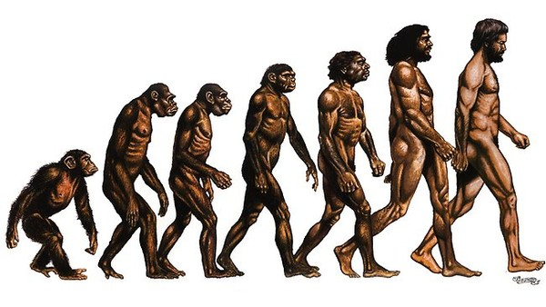
Genetic Algorithms
Based on evolutionary principals
Collection of genes forms a chromosome
All combinations of genes defines the search space
A chromosome defines a point in the search space

Slide 26
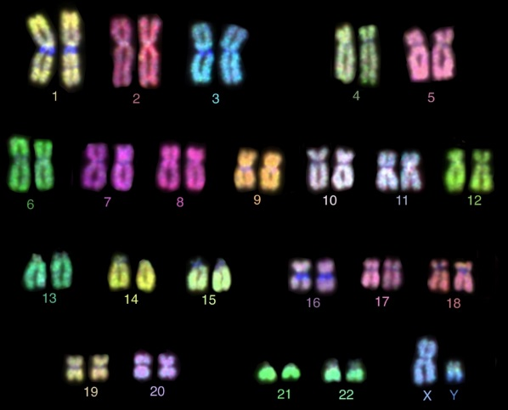
Genetic Algorithms
Create a population of chromosomes
Select the best chromosomes
Mate best to create a new generation
Crossover
Mutation
Elitism

Slide 27
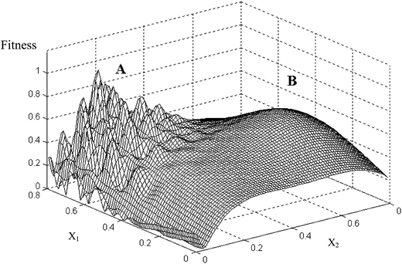
Genetic Algorithms
GAs outperform many other techniques when search space contains many optima

Slide 28
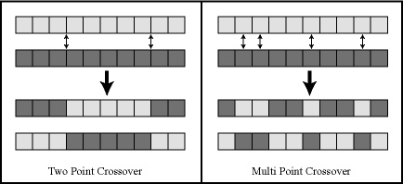
Crossover

Slide 29
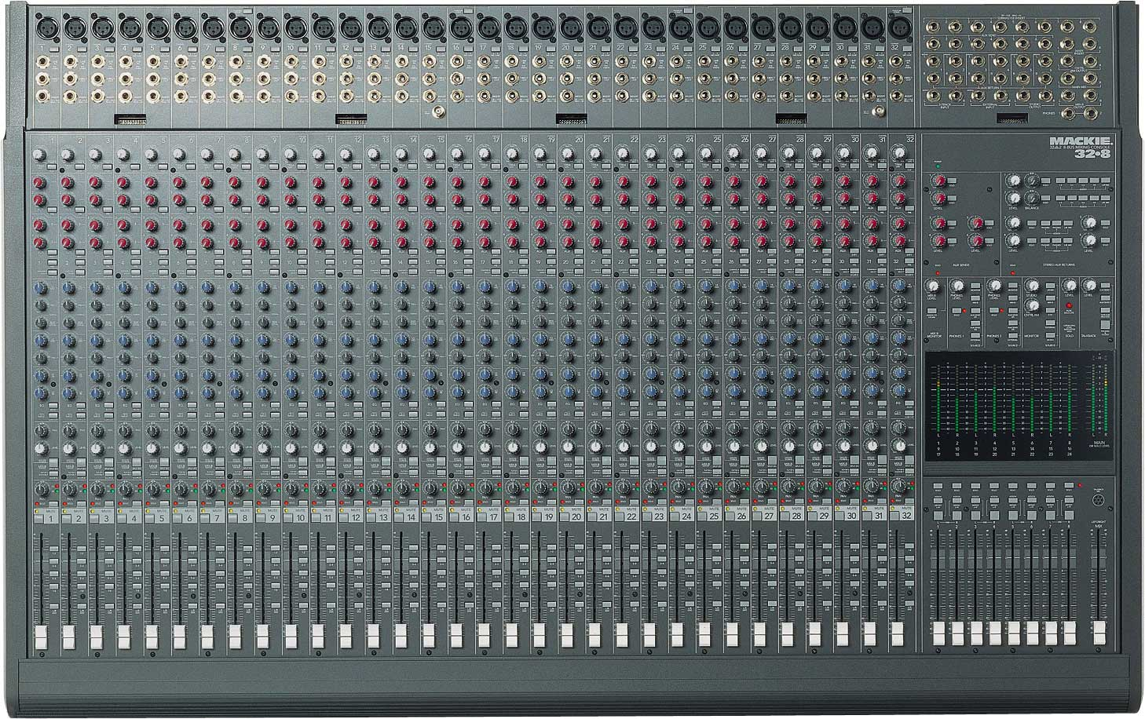
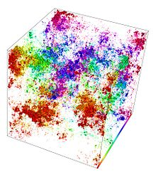
Genetic Algorithms: Optimization

Slide 30
Genetic Algorithms
Optimization technique
Not very useful for game development
Not guaranteed to find an optimal solution
Could be used during development to discover the best combination of settings

Slide 31
Genetic Algorithms Demos
Genome encoding:
Steering | Throttle | Steering | Throttle | …
BoxCar2D
http://boxcar2d.com/

Slide 32
Movie Time!

